Slide 1
Detecting fake news
RANJITH KUMAR J
SATHISH KUMAR S
MANIKANDA KARTHIKEYAN R
3rd Year BSC.COMPUTER TECHNOLOGY WITH IBM

Slide 2
DeTecting fake news
What is Fake News?
A type of yellow journalism, fake news encapsulates pieces of news that may be hoaxes and is generally spread through social media and other online media. This is often done to further or impose certain ideas and is often achieved with political agendas. Such news items may contain false and/or exaggerated claims, and may end up being viralized by algorithms, and users may end up in a filter bubble.

Slide 3
Decting FAKE NEWS
What is a TfidfVectorizer?
1. Term Frequency(TF)
The number of times a word appears in a document is its Term Frequency. A higher value means a term appears more often than others, and so, the document is a good match when the term is part of the search terms.
2. Inverse Document Frequency(IDF)
Words that occur many times a document, but also occur many times in many others, may be irrelevant. IDF is a measure of how significant a term is in the entire corpus.

Slide 4
Detecting fake news
What is a PassiveAggressiveClassifier?
Passive Aggressive algorithms are online learning algorithms. Such an algorithm remains passive for a correct classification outcome, and turns aggressive in the event of a miscalculation, updating and adjusting. Unlike most other algorithms, it does not converge. Its purpose is to make updates that correct the loss, causing very little change in the norm of the weight vector.

Slide 5
Detecting fake news
About Detecting Fake News with Python
This advanced python project of detecting fake news deals with fake and real news. Using sklearn, we build a TfidfVectorizer on our dataset. Then, we initialize a PassiveAggressive Classifier and fit the model. In the end, the accuracy score and the confusion matrix tell us how well our model fare

Slide 6
Detecting fake news
Source code
import numpy as npimport pandas as pdimport itertoolsfrom sklearn.model_selection import train_test_splitfrom sklearn.feature_extraction.text import TfidfVectorizerfrom sklearn.linear_model import PassiveAggressiveClassifierfrom sklearn.metrics import accuracy_score, confusion_matrix
#Read the data
df=pd.read_csv('D:\\DataFlair\\news.csv') #Get shape and head df.shape df.head()

Slide 7
Decting fake news
#DataFlair - Get the labels
labels=df.label
labels.head()
#DataFlair - Split the dataset x_train,x_test,y_train,y_test=train_test_split(df['text'], labels, test_size=0.2, random_state=7)
#DataFlair - Initialize a TfidfVectorizer tfidf_vectorizer=TfidfVectorizer(stop_words='english', max_df=0.7) #DataFlair - Fit and transform train set, transform test set tfidf_train=tfidf_vectorizer.fit_transform(x_train) tfidf_test=tfidf_vectorizer.transform(x_test)

Slide 8
Decting fake news
#DataFlair - Initialize a PassiveAggressiveClassifier pac=PassiveAggressiveClassifier(max_iter=50) pac.fit(tfidf_train,y_train) #DataFlair - Predict on the test set and calculate accuracy y_pred=pac.predict(tfidf_test) score=accuracy_score(y_test,y_pred) print(f'Accuracy: {round(score*100,2)}%’)
#DataFlair - Build confusion matrix confusion_matrix(y_test,y_pred, labels=['FAKE','REAL'])

Slide 9
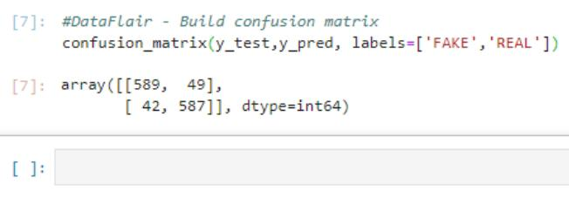
Detecting fake news

Slide 10
Detecting fake news
Github link
https://github.com/kumaranjith/Detect-fake-news/tree/main

Slide 11
THANK YOU

